Slide 1
Pilgrimage Images
"The Pilgrimage" by John Dawson Watson.

Slide 2
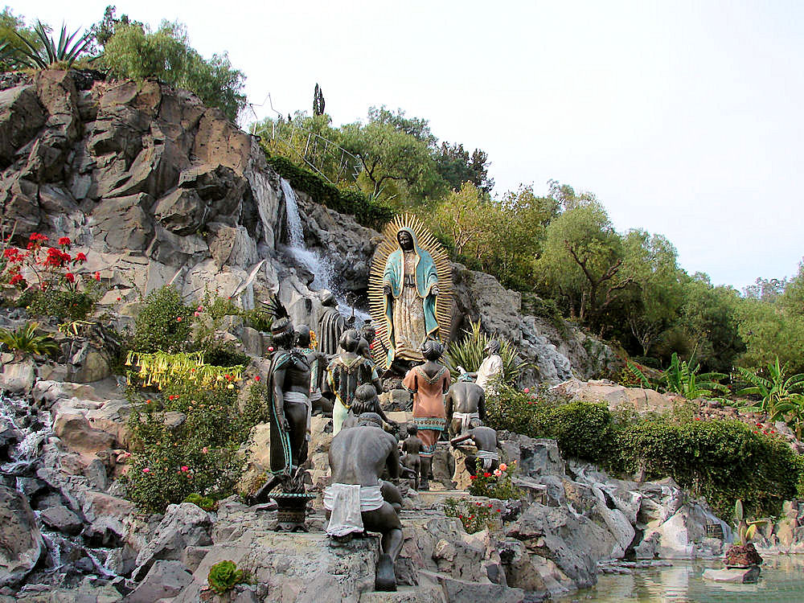
Tepeyac Hill: Our Lady of Guadalupe
http://www.delange.org/Guadalupe2/Jardin_del_Tepeyac_Garden_Basilica_de_Guadalupe.jpg

Slide 3
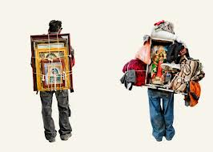

Slide 4
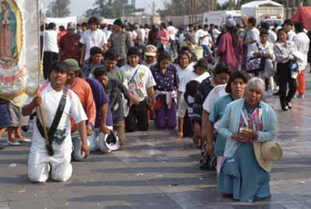

Slide 5
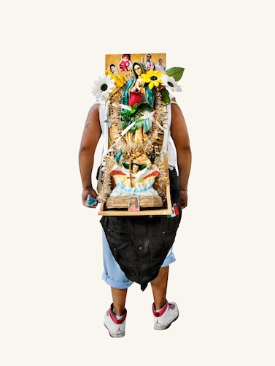

Slide 6
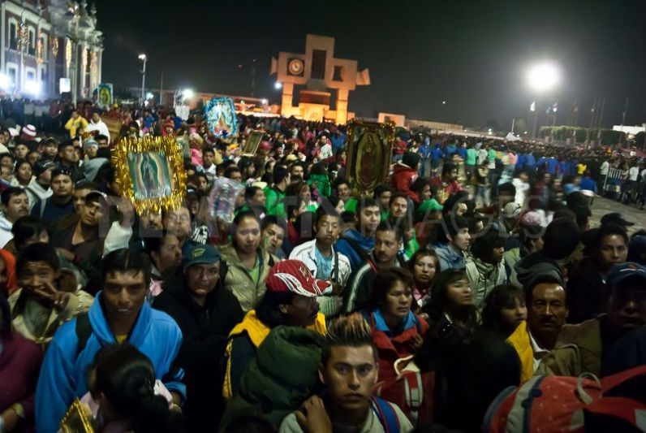

Slide 7
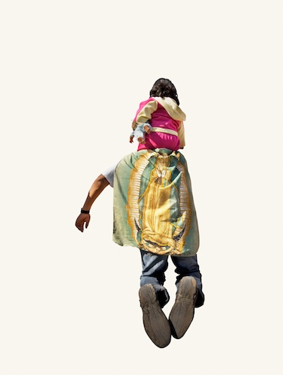

Slide 8
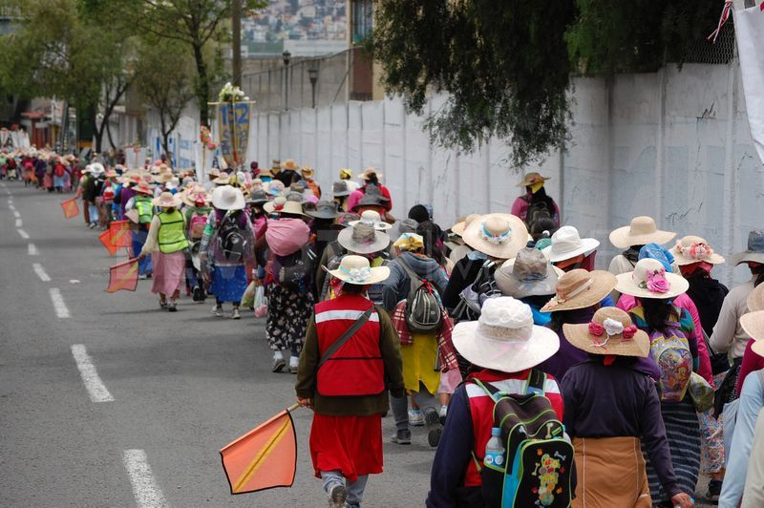

Slide 9
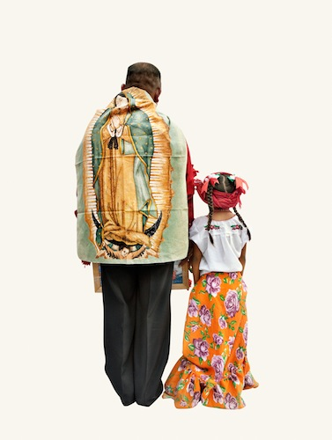

Slide 10
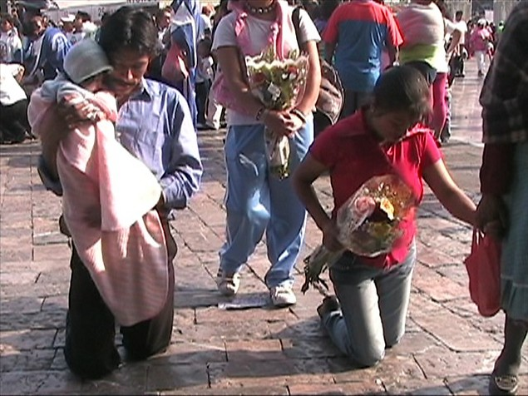

Slide 11
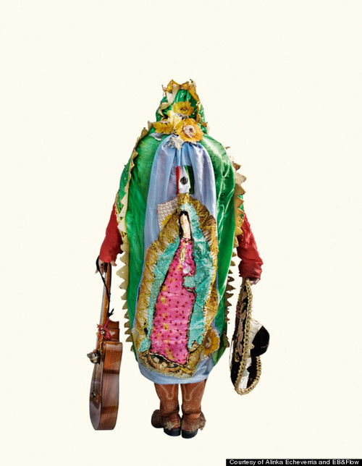

Slide 12
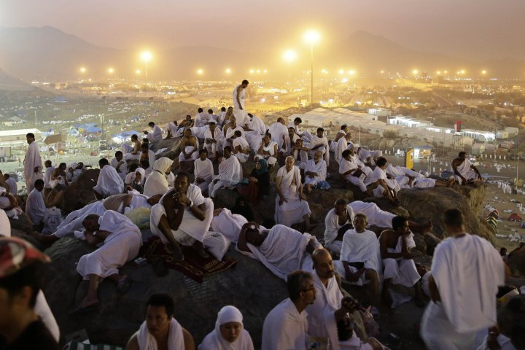
Muslim Pilgrimage to Mecca
http://world.time.com/2012/10/25/muslim-pilgrims-converge-on-mecca/photo/mideast-saudi-hajj/

Slide 13
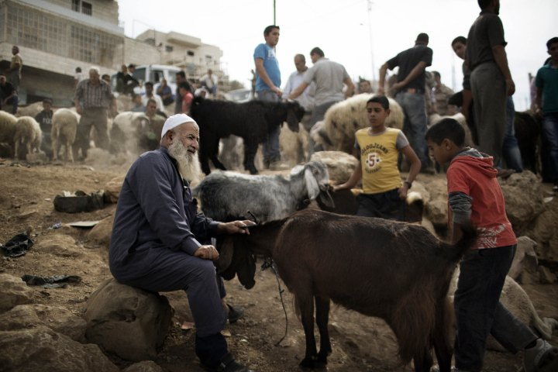

Slide 14
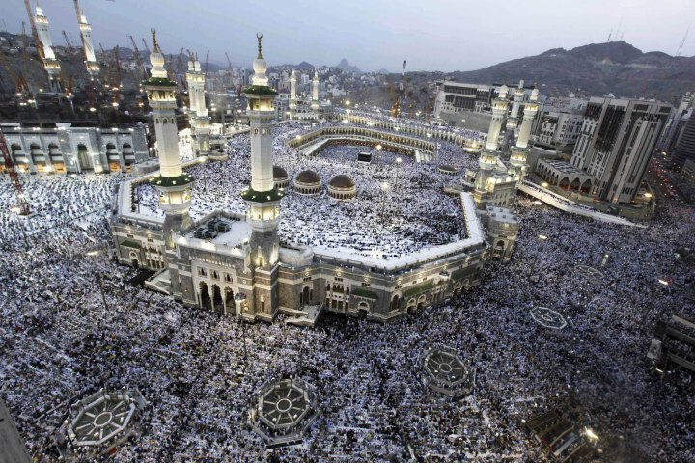

Slide 15
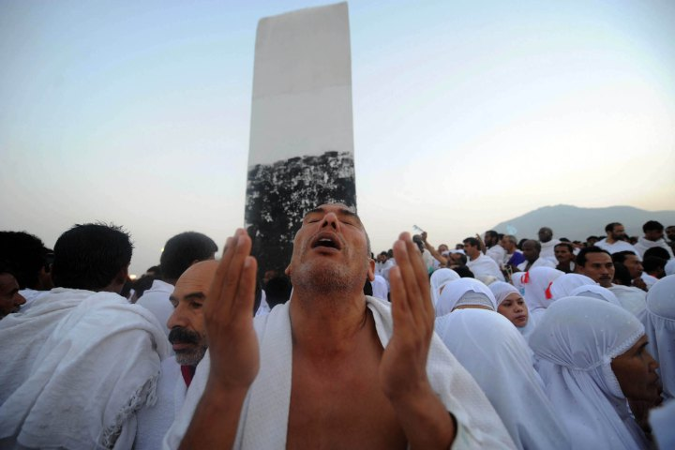

Slide 16
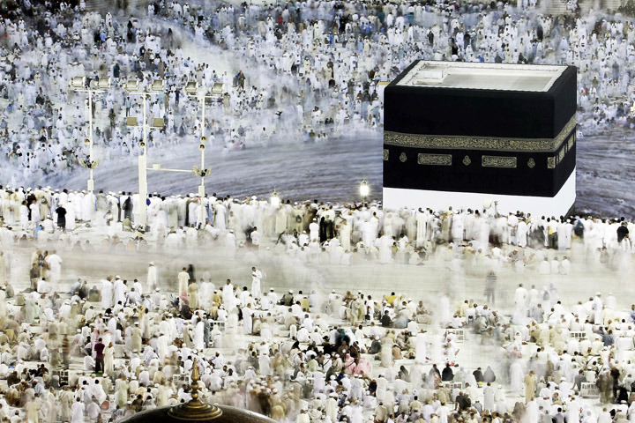

Slide 17
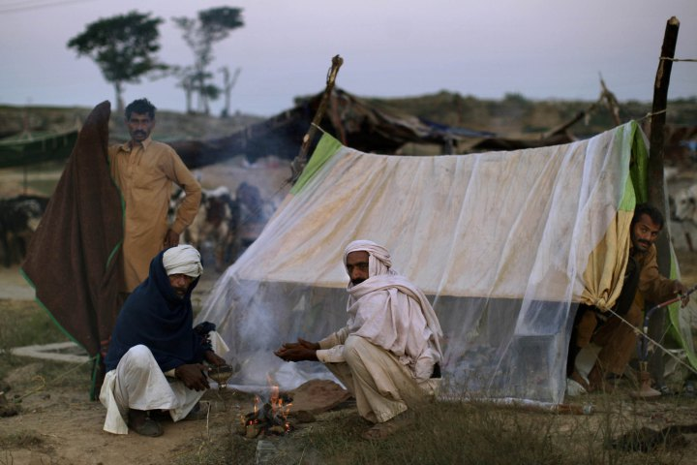

Slide 18
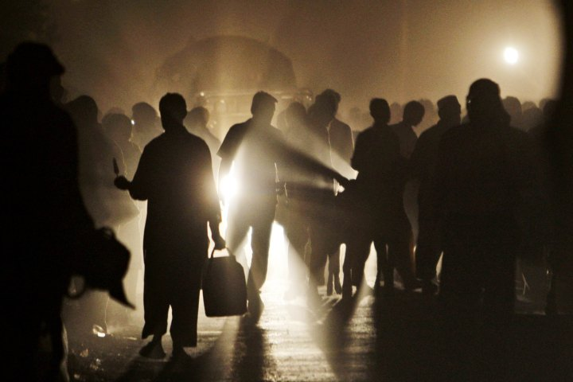

Slide 19
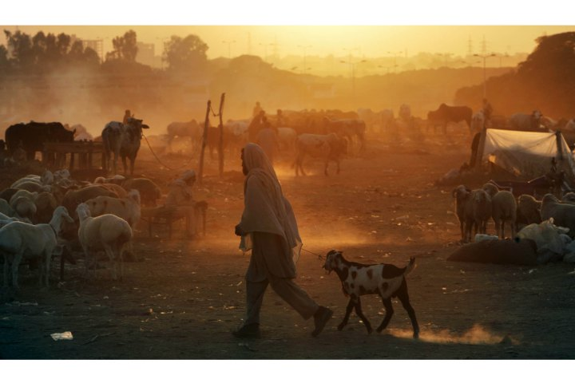

Slide 20
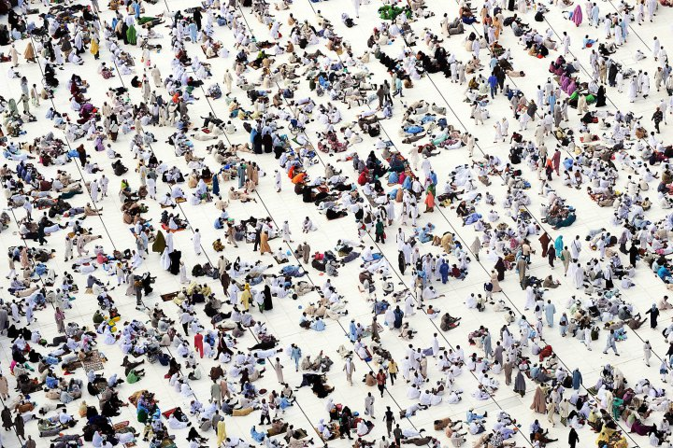

Slide 21
